Slide 1
Business Process Engineering
Quantitative Analysis
Lecture: 09
Instructor: Salman Ahmad

Slide 2
Process Analysis

Slide 3
Process Analysis Techniques
Qualitative analysis
Value-Added & Waste Analysis
Issue Register
Quantitative Analysis
Root-Cause Analysis
Pareto Analysis
Flow analysis
Queuing analysis
Simulation

Slide 4
Process performance
If you had to choose between two services, you would typically choose the one that is:
F…
C…
B…

Slide 5
Process performance
If you had to choose between two services, you would typically choose the one that is:
Faster
Cheaper
Better

Slide 6
Process performance
Process performance
Time
Cost
Quality
Notes:
A great deal of BPM is about continuously assessing and improving process performance, particularly across three dimensions – time, cost and quality.
In order to improve performance, we first have to measure it, and this is where process performance measures come into play.
Identifying which performance measures are most relevant for a given process is an art on its own.
In this section we will see some common measures along each of these dimensions.
Let’s start with time.

Slide 7
Time measures
Processing time
Waiting time
Cycle time
Time between start and completion of a process instance
Time taken by value-adding activities
Time taken by non-value-adding activities
Notes:
One of the most common time-related process performance measures is cycle time.
The cycle time of a process is the average time between the moment an instance of a process starts, and the moment it ends.
Cycle time has two components: the processing time, which is the time actually spent doing work, meaning doing activities of the process.
Waiting time, which is the rest of the time.
Waiting time has several sources as we will see subsequently, most notably the fact that a given activity may be ready to be executed, but the resource who will execute it is not available.

Slide 8
Cycle time efficiency
Processing Time
Cycle Time
Cycle Time Efficiency

Slide 9
Cost measures
Processing cost
Cost of waste
Per-Instance Cost
Cost of value-adding activities
Cost of a process instance
Cost of non-value-adding activities

Slide 10
Typical components of cost
Material cost
Cost of tangible or intangible resources used per process instance
Resource cost
Cost of person-hours employed per process instance

Slide 11
Resource utilization
Time spent per resource on process work
Time available per resource for process work
Resource utilization
Resource utilization = 60%
➔ on average resources are idle 40% of their allocated time

Slide 12
Resource utilization vs. waiting time
Resource utilization
Waiting time
Typically, when resource utilization > 90%
➔ Waiting time increases steeply

Slide 13
Quality
Defect rate
Delivery quality
Customer satisfaction
Product quality
On-time delivery rate
Customer feedback score
Cycle time variance

Slide 14
Identifying performance measures
For each process, formulate process performance objectives
For each objective, identify variable(s) and aggregation method ➔ performance measure
Variable: customer served in < 30 min.
Aggregation method: percentage
Measure: ST₃₀ = % of customers served in < 30 min.
For each performance measure, define targets
ST₃₀ > 99%
Customer should be served always in a timely manner

Slide 15
Flow Analysis

Slide 16
Flow analysis
Process model
Performance of each activity
Process performance
Notes:
Flow analysis a technique to estimate and understand the performance of a process, given a process model and performance measures of the activities in the process
For example if we are given a process model and the cycle time of each activity in the process, we can use flow analysis to calculate the performance of the process. In doing so, we can understand where the performance of the process is coming from, that is, which activities in the process affect the most to the performance of the overall process.
In the following, we will show how flow analysis works using time measures, but we can do the same for cost and quality measures as discussed in the recommended readings.

Slide 17
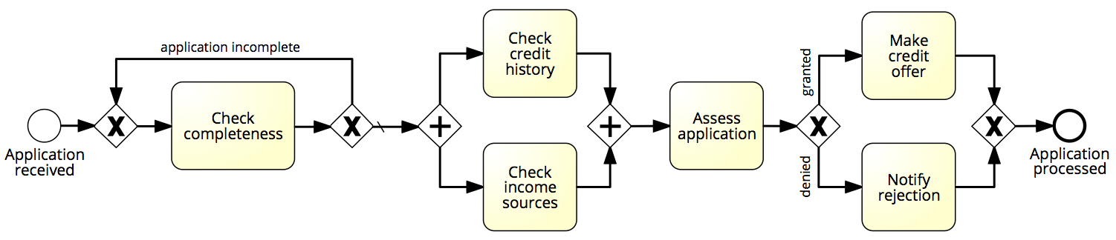
Flow analysis of cycle time
1 day
1 day
1 day
3 days
3 days
2 days
Cycle time = X days

Slide 18
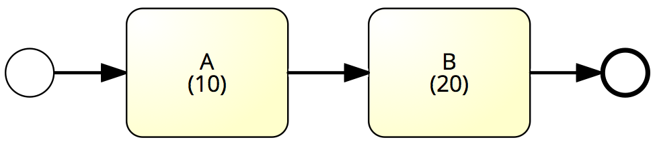
Sequence – Example
What is the average cycle time?
Cycle time = 10 + 20 = 30

Slide 19
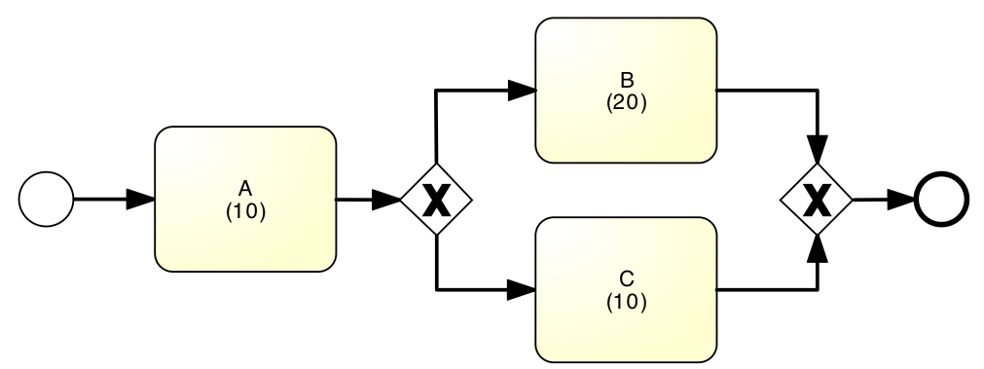
Example: Alternative Paths
What is the average cycle time?
50%
90%
50%
10%
Cycle time = 10 + (20+10)/2 = 25
Cycle time = 10 + 0.9*20+0.1*10 = 29

Slide 20
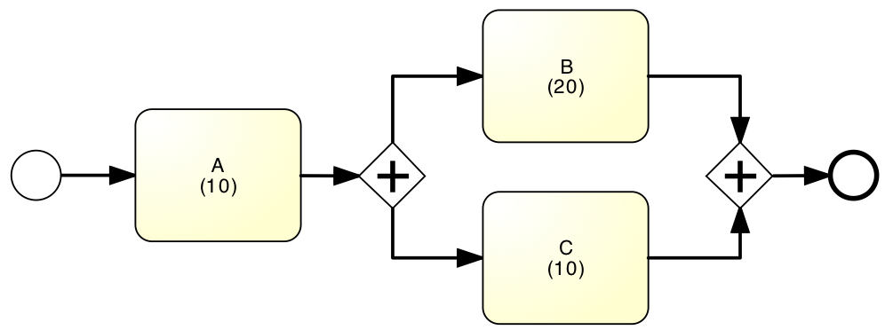
Example: Parallel paths
What is the average cycle time?
Cycle time = 10 + 20 = 30

Slide 21
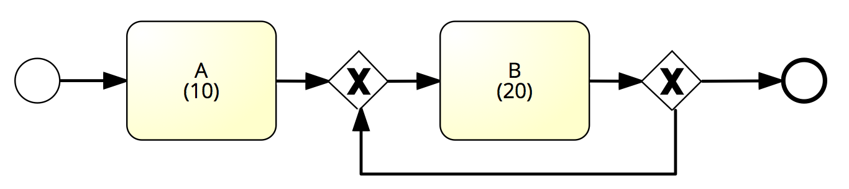
Example: Rework loop
What is the average cycle time?
80%
100%
1%
0%
99%
20%
Cycle time = 10 + 20 = 30
Cycle time = 10 + 20/0.01 = 2010
Cycle time = 10 + 20/0.8 = 35

Slide 22
Flow analysis equations for cycle time
CT = T₁+T₂+…+ T_{N}
CT = p₁*T₁+p₂*T₂+…+ p_{n}*T_{N}
CT = max(T₁, T₂,…, T_{N})
CT = T / (1-r)

Slide 23
Flow analysis of cycle time
1 day
1 day
20%
60%
80%
1 day
3 days
40%
3 days
2 days
1/0.8
max(1,3)
3
0.6*1+0.4*2
Cycle time = 1.25 + 3 + 3 + 1.4 = 8.65 days

Slide 24
Flow analysis of processing time
0.5 hour
2 hours
20%
60%
80%
2 hours
2 hours
40%
3 hours
0.5 mins.
2/0.8
max(0.5,3)
2
0.6*2+0.4*0.5
Processing time = 2.5 + 3 + 2 + 1.4 = 8.9 hours
Cycle time efficiency = 8.9 hours / 8.65 days = 12.9%

Slide 25
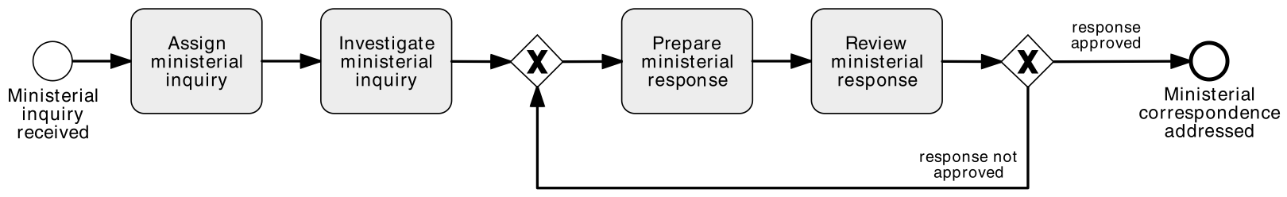
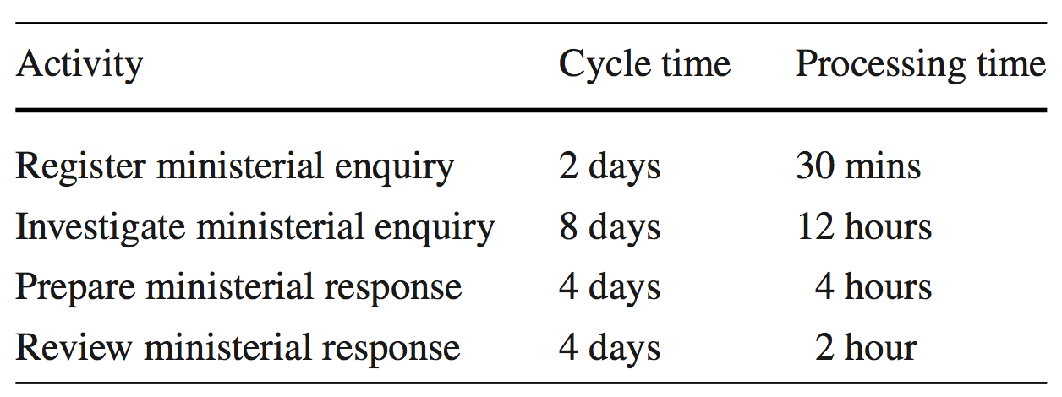
Exercise: Calculate CTE of the following process

Slide 26
Flow analysis: scope and limitations
Flow analysis for cycle time calculation
Other applications:
Calculating cost-per-process-instance
Calculating error rates at the process level
Estimating capacity requirements
But it has its limitations…

Slide 27
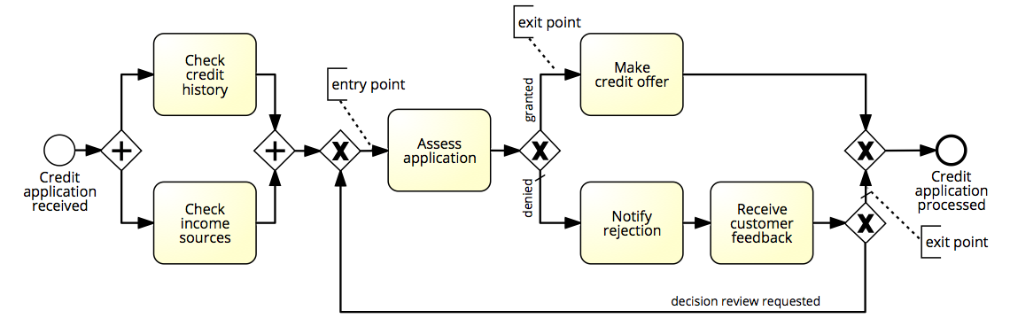
Limitation 1: Not all Models are Structured

Slide 28
Limitation 2: Fixed arrival rate capacity
Cycle time analysis does not consider:
The rate at which new process instances are created (arrival rate)
The number of available resources
Higher arrival rate at fixed resource capacity ➔ high resource contention ➔ higher activity waiting times (longer queues) ➔ higher activity cycle time ➔ higher overall cycle time
The slower you are, the more people have to queue up…
and vice-versa

Slide 29
Cycle Time & Work-In-Progress
WIP = (average) Work-In-Process
Number of cases that are running (started but not yet completed)
E.g. # of active and unfilled orders in an order-to-cash process
WIP is a form of waste (cf. 7+1 sources of waste)
Little’s Formula: WIP = λ·CT
λ = arrival rate (number of new cases per time unit)
CT = cycle time

Slide 30
Exercise
A fast-food restaurant receives on average 1200 customers per day (between 10:00 and 22:00). During peak times (12:00-15:00 and 18:00-21:00), the restaurant receives around 900 customers in total, and 90 customers can be found in the restaurant (on average) at a given point in time. At non-peak times, the restaurant receives 300 customers in total, and 30 customers can be found in the restaurant (on average) at a given point in time.
What is the average time that a customer spends in the restaurant during peak times?
What is the average time that a customer spends in the restaurant during non-peak times?

Slide 31
Exercise (cont.)
The restaurant plans to launch a marketing campaign to attract more customers. However, the restaurant’s capacity is limited and becomes too full during peak times. What can the restaurant do to address this issue without investing in extending its building?

Slide 32
Chapter 7
Fundamentals of Business Process Management
Marlon Dumas, Marcello La Rosa, Jan Mendling, Hajo A. Reijers
Springer 2018

